Slide 1
Ecology 8310 Population (and Community) Ecology
How do we study competition?
Pattern
Experiments
De Wit Replacement Series (substitutive)
Additive designs
Full designs or Response Surfaces
Target-Neighbor experiments
Notes:
We've already seen some examples with protists and phytoplankton, but let's look at other cases. Expecially cases in which we cannot observe many generations play out in real time. Often we must infer competition from short-term experiments.

Slide 2
Beyond chemo-stats:
How do we empirically study competition?
Pattern
Experimentation
Mechanism

Slide 3
Pattern
Spatial
Temporal
Notes:
Look for negative associations in space or time. What are limitations of this approach? E.g., Examine the spatial pattern of two competitors across a heterogeneous landscape. What do you expect to see?
Temporal patterns: e.g., Tony Ives (U Wisconsin) – effects inferred by time series.

Slide 4
Experiments

Slide 5
De Wit Replacement Series
(substitutive design)

Slide 6
Keep the total seed number the same
Vary the proportion of two species
Quantify seed production of each species

Slide 7
Density of Sp. 2
Density of Sp. 1

Slide 8
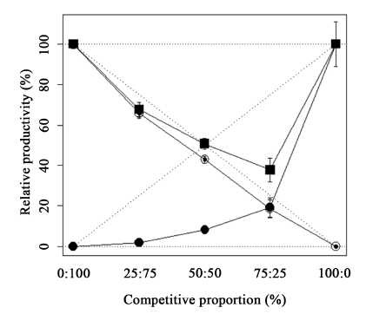
Data from Galon et al. 2015 (Am. J. Plant Sci.)
Overyielding
Intra=inter
Underyielding
Seed output (percent)
Seed input (percent)
Why do you get over- vs. under-yielding?
What if intra=inter?
Notes:
Niche-partitioning→Intra>inter→ overyielding. (overyielding happens when the single yield curves are bowed up above the dotted lines – each one increases it's relative representation when rare → it increases when rare, so coexistence. )
Intra<inter → underyielding (i.e., mixtures do worse overall than monocultures).

Slide 9
Additive designs

Slide 10
Quantify the effect of Sp.2 on Sp.1
Is the effect due to Sp2 or just a generic effect of density?
Density of Sp. 2
Density of Sp. 1

Slide 11
Density of Sp. 2
Density of Sp. 1

Slide 12
Minimal design
(to quantify effect of inter and intraspecific effects)

Slide 13
Density of Sp. 2
Density of Sp. 1
Notes:
But it doesn’t address non-linearities…

Slide 14
Effect of Sp2 on Sp2 (intra)
Density of Sp. 2
Effect of Sp1 on Sp2 (inter)
Density of Sp. 1
Notes:
But it doesn’t address non-linearities…

Slide 15
Density of Sp. 2
Effect of Sp2 on Sp1 (inter)
Effect of Sp1 on Sp1 (intra)
Density of Sp. 1
Notes:
But it doesn’t address non-linearities…

Slide 16
Response Surface

Slide 17
Advantages:
Quantify intra vs. inter
Evaluate non-linearities
Describes entire response surface
Density of Sp. 2
Density of Sp. 1
But a lot more work

Slide 18
Responses: individuals or populations?

Slide 19
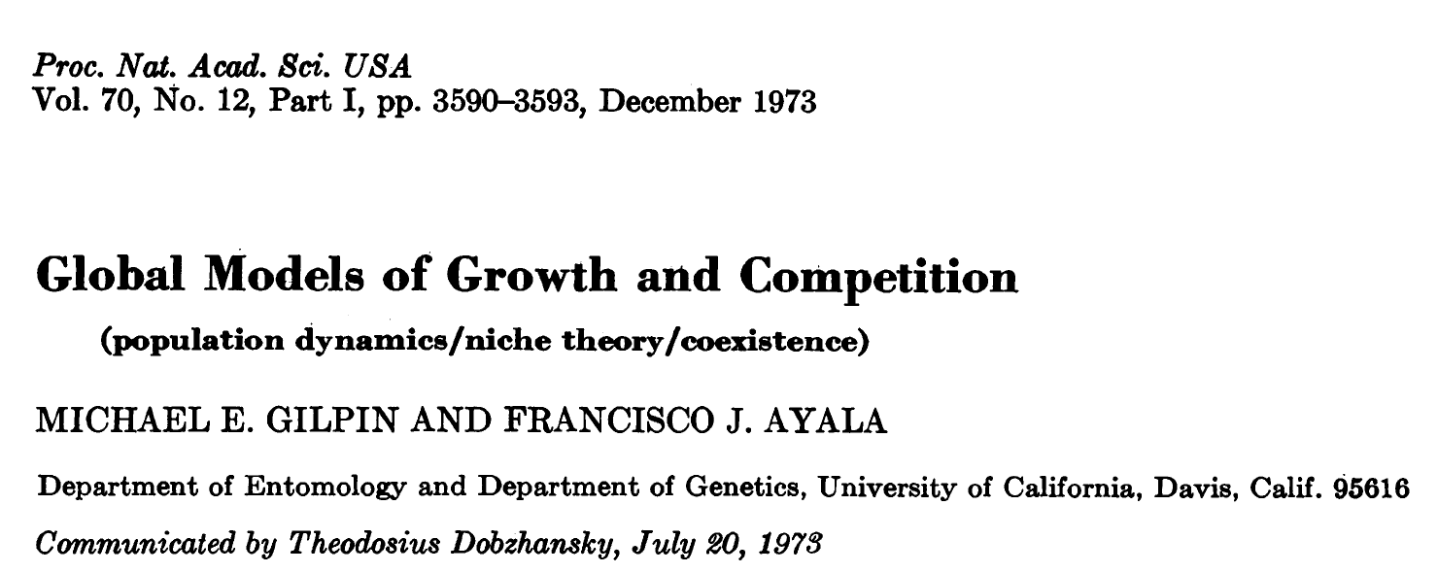
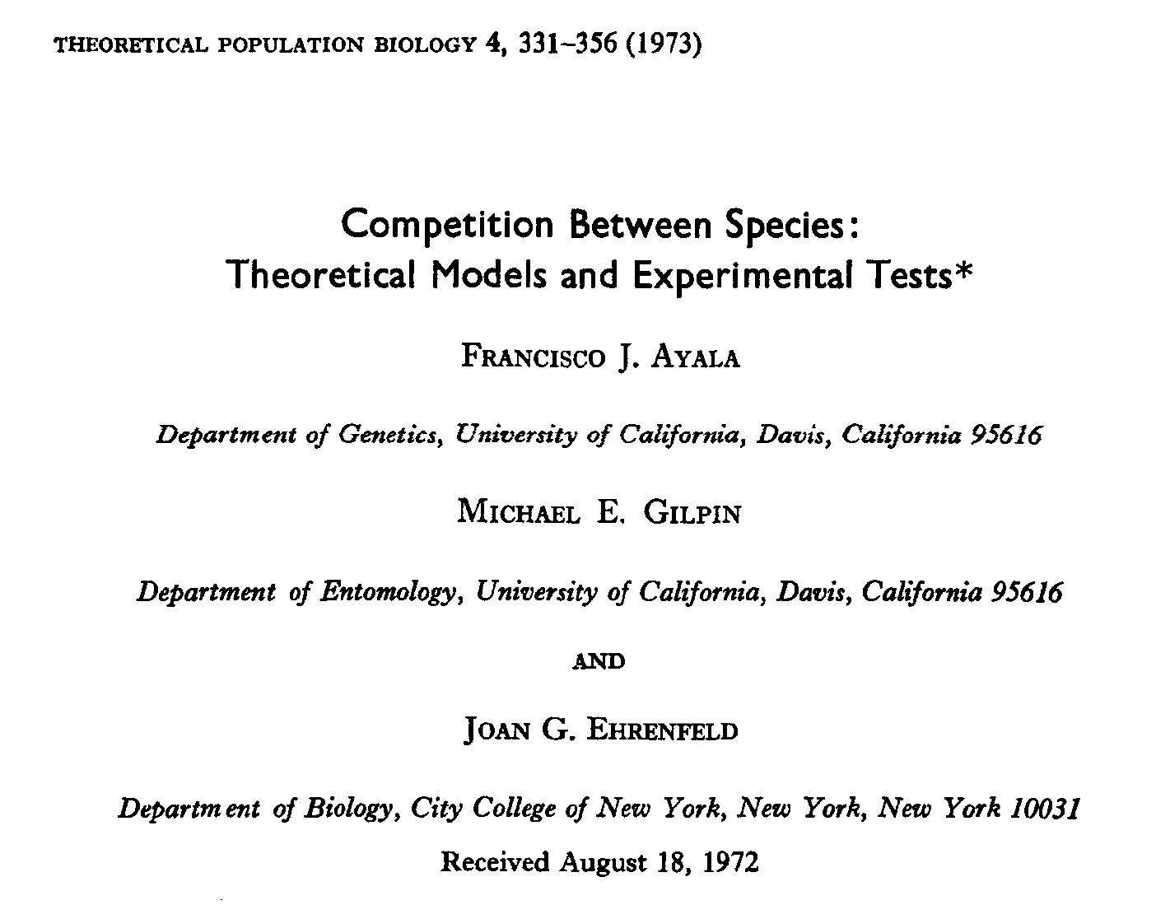

Slide 20
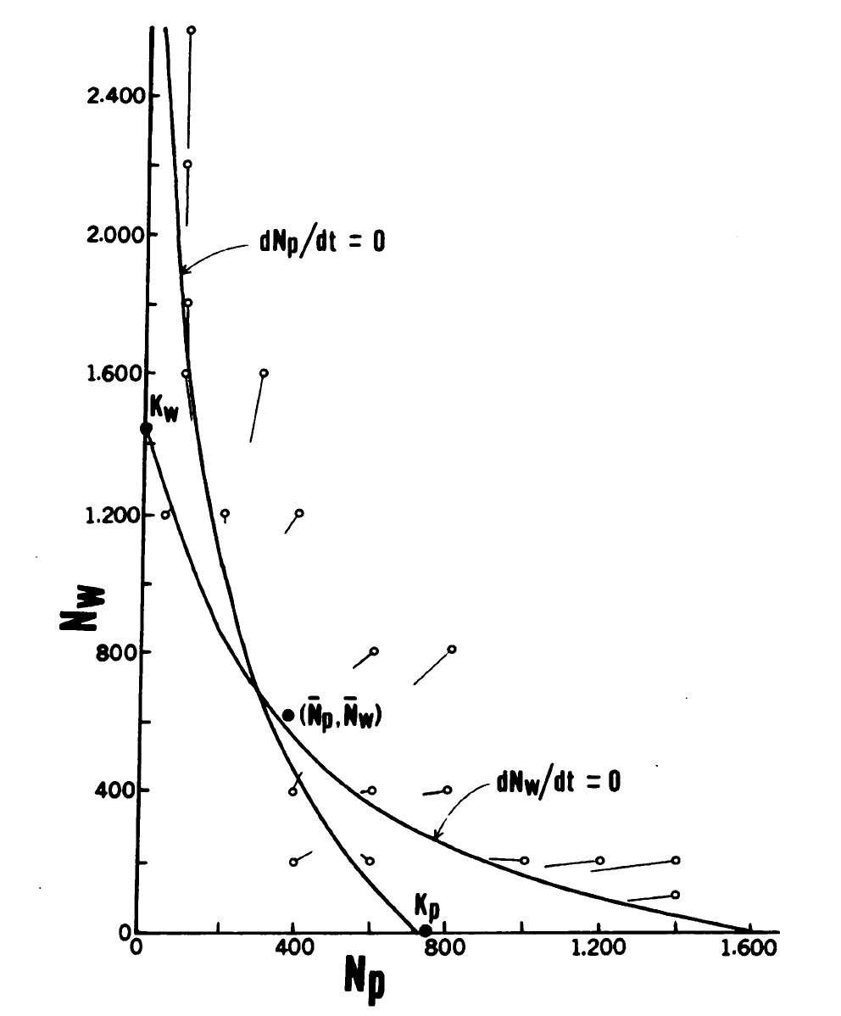
Two species of Drosophila, D. willistoni and D. pseudoobscura
Set up at a range of densities
Monitored pop. sizes at start and after reproduction
Plotted on phase-plane
Compared to independent estimates of 1- and 2-species equilibria.

Slide 21
Another approach (focus on individuals):
Target-Neighbor Designs

Slide 22
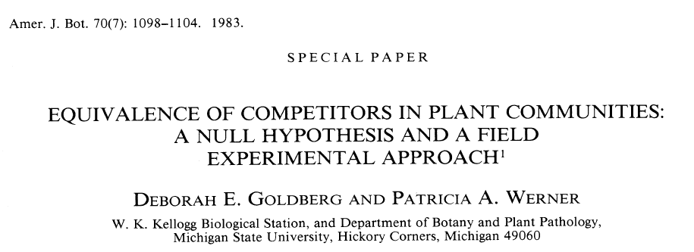
Target-Neighbor Designs

Slide 23
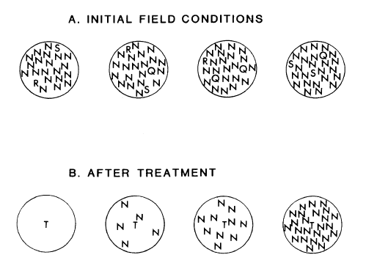
Notes:
Explain rationale for equivalance.

Slide 24
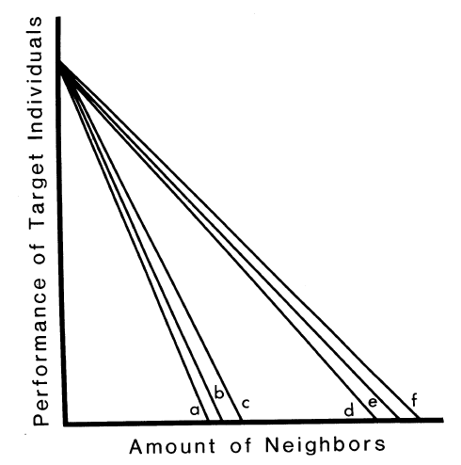
Compare effects of 6 different neighbor species on 1 target species…
Equivalent effects
Notes:
Explain rationale for equivalance.

Slide 25
Different effects:
Different responses:
Species 3 has the largest effect:
Species 1 is the least affected:

Slide 26
“Equivalence” provides a null hypothesis:
if neighbor biomass (resources acquired) drives competitive effects, then neighbors should yield equal effects (when compared with respect to their biomass).

Slide 27
Neighbor species
Equivalence?
Rejected, although per-gram effects were much more similar than per-plant effects
Trifolium = weak effects (N-fixer?)
Phleum = strong effects
Target species
Notes:
T = trifolium (clover – N fixing)
Phleum = timothy grass

Slide 28
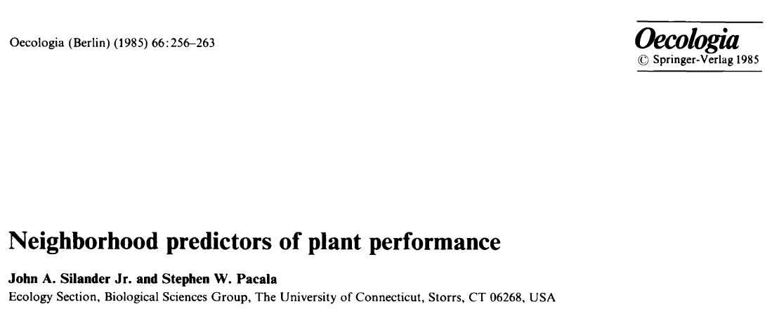
Notes:
Explain rationale for equivalance.

Slide 29
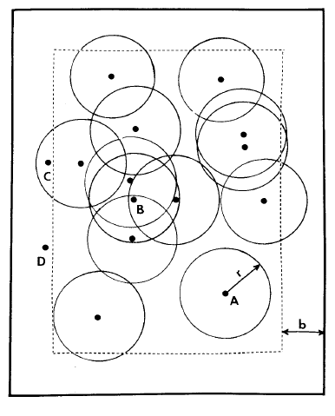

Slide 30
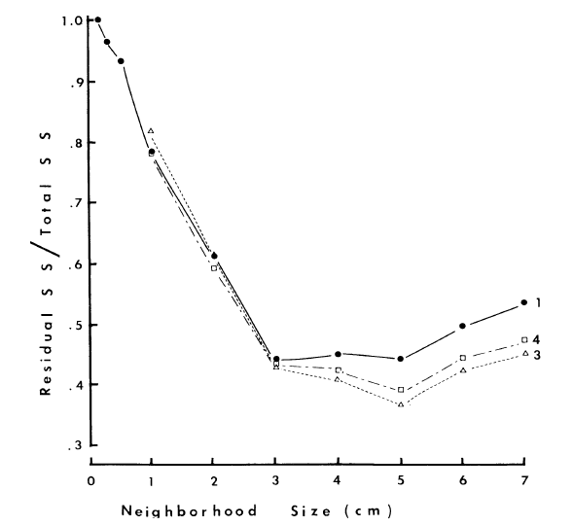
Compared different models (1,3,4) but all showed minimum around 5cm

Slide 31
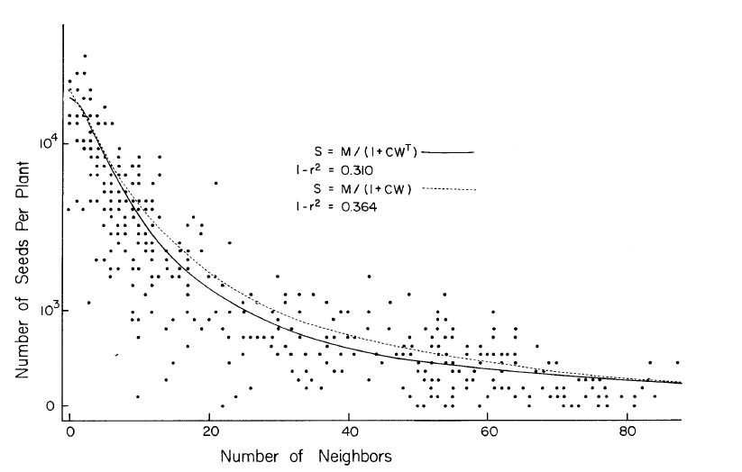
Notes:
And they then went on to use those neighborhood models to project spatial dynamics….

Slide 32
Another approach using resource-based mechanisms:
R* with terrestrial plants

Slide 33
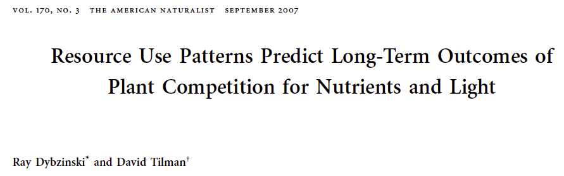
Grew monocultures of 6 species for 11 years. Determine R* (nitrogen) and I* (light).
Crossed with total N (supply point))
Also grew combinations of spp.
Notes:
The concept of R* for light is a bit controversial –light is intercepted by the canopy and isn’t the same as nutrients.
Also, R* theory was originally developed for phytoplankton in well mixed systems. Soils are very heterogeneous, so more recent approaches have developed more complex mechanistic models of competition – but they often give very similar predictions as the simply R* theory – which still underlies much of our thinking about competition, so let’s see what they found in this study...(caveats in mind).

Slide 34
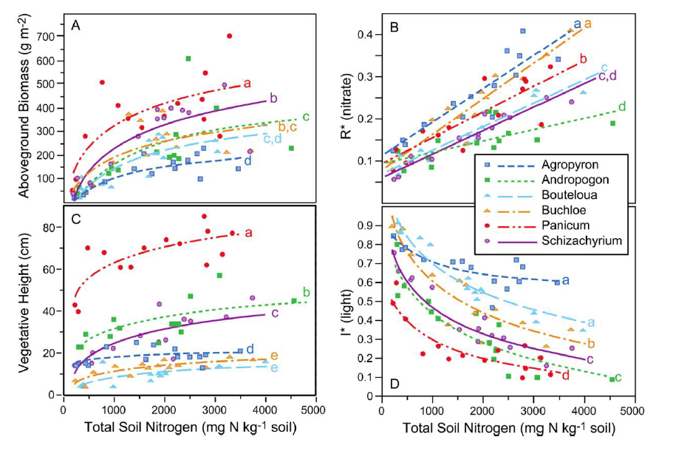
Notes:
(so why does R* increase with TN? I think it’s because the ZNGIs are are not ”essential (which is odd), but possibly because as TN goes up (i.e., supply point increases in N dimension), the equil slides along a slanted ZNGI and R* then increases while I* decreases). This may be more about the challenges with light as a resource as it is about essential reources, per se. I’m really not sure.

Slide 35
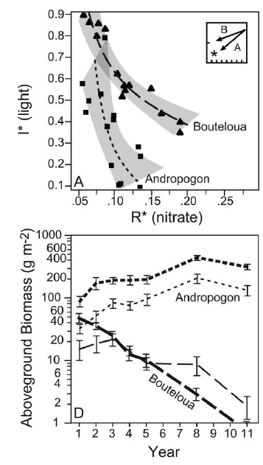
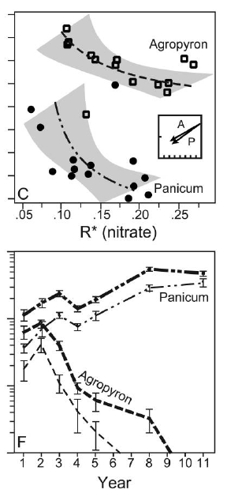
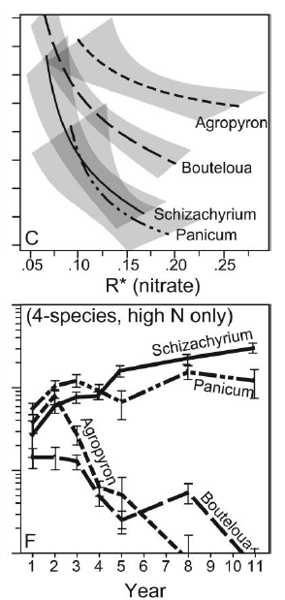

Slide 36
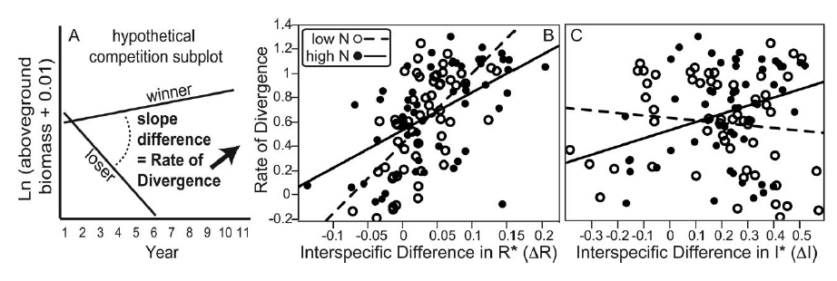
Notes:
Rate of exclusion was correlated with the degree of disparity in R* (not so much I*; althou there was a pattern under hi N, where light limitation was more severe).

Slide 37
“only a few of our paired species coexisted under our experimentally imposed conditions (homogeneous soils, high seeding densities, minimal disturbance, regular water, and low herbivory levels), suggesting that other coexistence mechanisms help generate the diversity observed in natural communities”

Slide 38
Bottom-lines:
Experimental approaches (good for revealing causation, but time scale is limited)
Observational approaches (poor for causation, but time scale often more appropriate)
Resource-based “mechanism” helpful
Caveat 1: Other factors have been omitted
Caveat 2: responses often measured on individuals vs. populations

